Slide 1
WhatsApp: The Best Facebook Purchase Ever?
Milici Andrei-Cristian
Group 1719

Slide 2
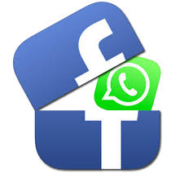
One of the greatest acquisitions
With so much cash thrown around in Silicon Valley, it’s not easy for an acquisition to cause a stir. Facebook’s (FB) acquisition of WhatsApp last year did just that – surpassing Google’s (GOOG) $3.2 billion purchase of Nest Labs and Apple’s (AAPL) $3 billion Beats Electronics procurement – to become 2014’s top acquisition and one of the largest tech buys of all time.

Slide 3
What is whatsapp and when did facebook actually bought it?
WhatsApp is an ad-free mobile application that allows users to send unlimited messages to contacts without using the wireless network or sustaining data fees. The app is free to download (but a $1 subscription kicks in after the first year) and is an alternative to the cell provider’s traditional text messaging platform. The app was founded by Jan Koum and Brian Acton, two former Yahoo! (YHOO) executives.
When Facebook announced its plans to acquire WhatsApp in February 2014, WhatsApp's founders attached a purchase price of $16 billion: $4 billion in cash and $12 billion remaining in Facebook shares. This price tag is dwarfed by the actual price Facebook paid: $21.8 billion, or $55 per user.

Slide 4
Why whatsapp?
First of all
Second of all
The answer is user growth. Over 500 million people use WhatsApp monthly and the service currently adds more than 1 million users per day.
Seventy percent of WhatsApp users are active daily, compared to Facebook’s 62%. Additionally, WhatsApp users send 500 million pictures back and forth per day, about 150 million more than Facebook users.

Slide 5
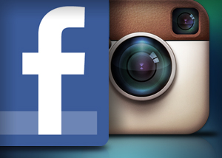
Previous Facebook Acquisitions
In 2012, Facebook announced its plans to acquire Instagram, a popular photo sharing site that boasts 200 million active users. Not only did Facebook plan to enhance its own photo sharing features, but it also wanted to prevent any competitor from getting to the well-liked company first. Facebook bought Instagram for $1 billion: $300 million in cash and the remainder in over $700 million in Facebook stock.
INSTAGRAM!!!

